Slide 1
Grade 7 Supplementary English course
By Washington English Center

Slide 2
Unit 8: Films
Lesson 1
Page 64

Slide 3
Vocabulary
action | educational | funny | moving
romance | comedy | horror | documentary
clever | animated | romantic | science-fiction
scary | exciting | interesting | violent

Slide 4
LISTEN AND REPEAT
Nghe và đọc theo giáo viên
Action:
Romance:
Clever:
Scary:
Hành động
Tình cảm
Thông minh
Đáng sợ
Notes:
A, B, D: /k/
C: /s/

Slide 5
LISTEN AND REPEAT
Nghe và đọc theo giáo viên
Educational:
Comedy:
Animated:
Exciting:
Giáo dục
Phim hài
Hoạt hình
Phấn khích
Notes:
A, B, D: /k/
C: /s/

Slide 6
LISTEN AND REPEAT
Nghe và đọc theo giáo viên
Funny:
Horror:
Romantic:
Interesting:
Buồn cười
Kinh dị
Lãng mạn
Thú vị
Notes:
A, B, D: /k/
C: /s/

Slide 7
LISTEN AND REPEAT
Nghe và đọc theo giáo viên
Moving:
Documentary:
Science-fiction:
Violent:
Di chuyển
Tài liệu
Khoa học viễn tưởng
Bạo lực
Notes:
A, B, D: /k/
C: /s/

Slide 8
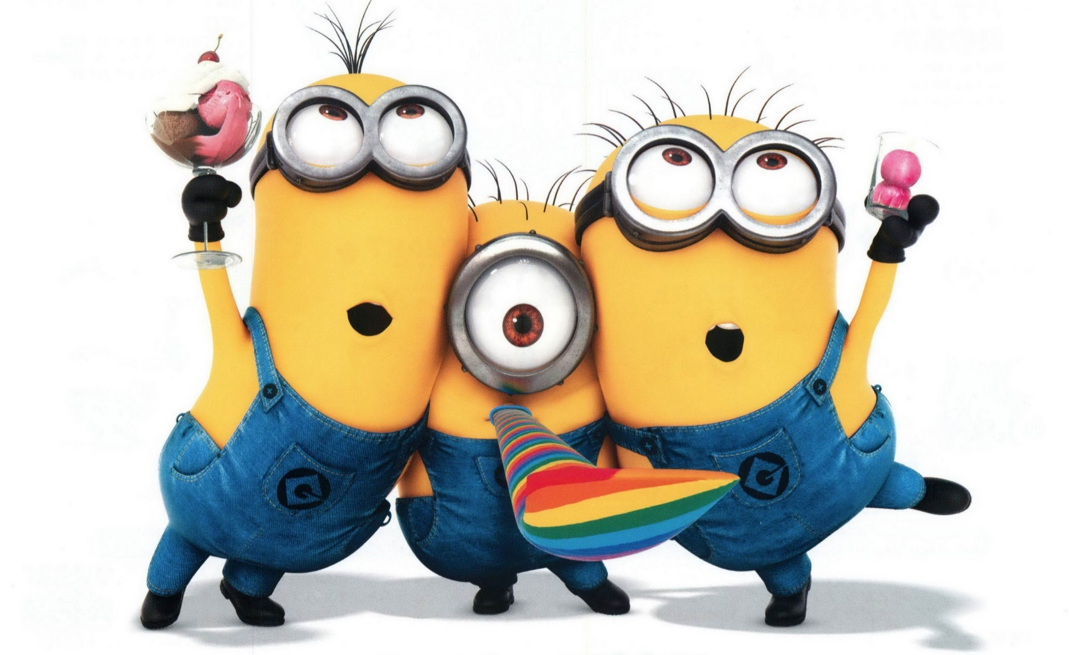
Animated
Hoạt hình
GUESS THE WORD
Đoán từ

Slide 9
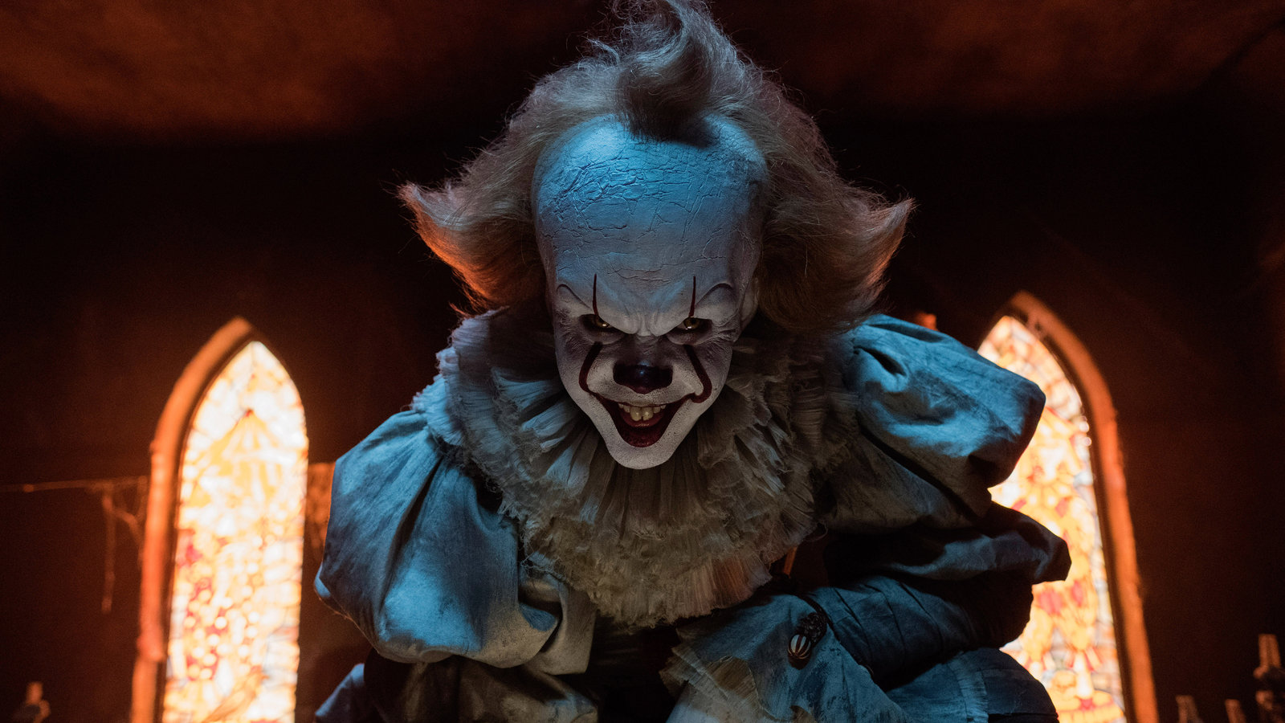
Horror
Kinh dị
GUESS THE WORD
Đoán từ

Slide 10
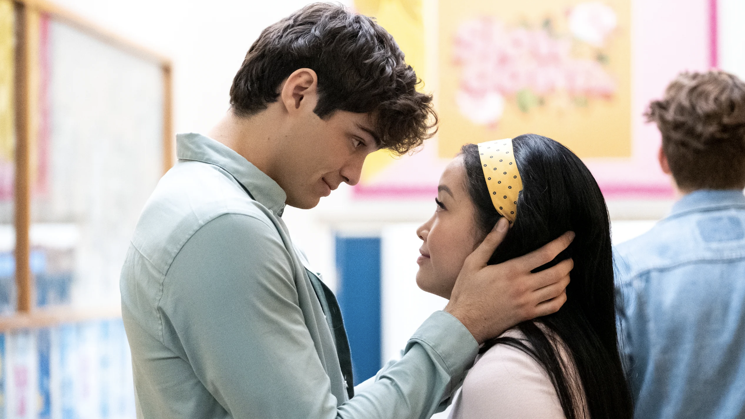
Romance
Tình cảm
GUESS THE WORD
Đoán từ

Slide 11
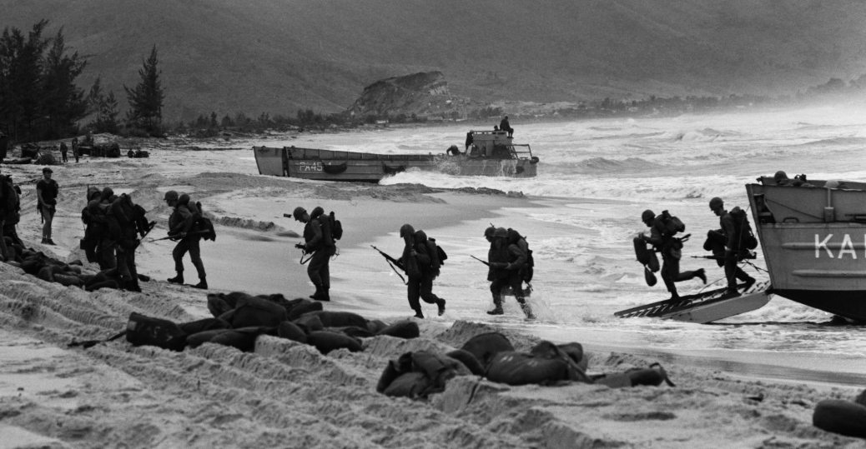
Documentary
Tài liệu
GUESS THE WORD
Đoán từ

Slide 12
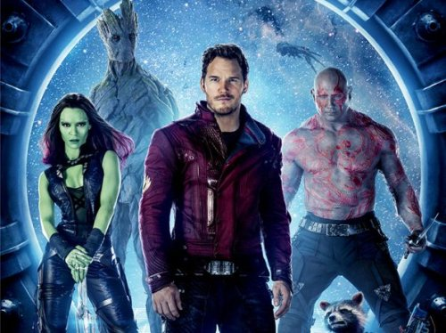
Science-fiction
Khoa học viễn tưởng
GUESS THE WORD
Đoán từ

Slide 13
Action:
Hành động
GUESS THE WORD
Đoán từ

Slide 14
Notes:
A, C, D: /e/
B: /ɪ/

Slide 15
Plot: thrilling, terrifying, delicious, fascinating
Characters: convincing, fresh, believable, interesting
Script: interesting, amusing, excellent, bad-tempered
Acting: brilliant, fantastic, lazy, wonderful

Slide 16
Action | Scary
Romance | Violent
Science Fiction | Romantic
Horror | Sad
Animated | Educational
Documentary | Funny
Comedy | Exciting
Pair work. Ask and answer about films. Use words and phrases in the vocabulary box.
A: What was the film like yesterday?
B: It was brilliant! I want to see it again!

Slide 17
Brief Encounter: Laura Jesson meets Doctor Alec Harvey. They are married, but they continue to meet every week at a station. This is a beautiful, but sad (1) _____________.
love story
Forrest Gump: Tom Hanks is very funny in this wonderful (2) _____________. Hanks won his second Oscar for his acting.
comedy

Slide 18
Minority Report: In the year 2054, the police can see the future. Tom Cruise is a policeman John Anderton in his exciting (3) _____________.
sci – fi
The Blues Brothers: Jake and his brother, Elwood, decide to play their last concert. An exciting (4) _____________ with songs from Aretha Franklin.
musical
Elizabeth: This (5) ________________ tells the interesting story of the English queen, Elizabeth I (1558 – 1603).
historical drama

Slide 19
Win a Date with Tad Hamilton: In a competition, Rosalee wins a date with Tad Hamilton, a good-looking and famous actor. Will they fall in love? A simple, but very funny (6) _____________.
romantic comedy
Little Big Man: An old man tells the story of his life. There are cowboys, Indians and everything you expect in this classic (7) _____________.
western
Psycho: Don’t watch this alone! A woman stops at a lonely hotel in Alfred Hitchcock’s famous (8) _____________.
horror film

Slide 20
PRONUNCIATION
Task 5. Listen and repeat the verbs. Pay attention to the sounds /t/, /d/ and /ɪd/ at the end of each verb
/t/ | /d/ | /ɪd/
played | danced
walked | opened
waited | viewed
needed | washed
watched | bored
closed | hated
waited
walked
played
watched
closed
needed
danced
opened
hated
washed
viewed
bored

Slide 21
LISTENING
 | Name of movie | How they describe it
Becky |  | □ scary □ exciting | □ funny □ clever
Rich |  | □ funny □ moving | □ romantic □ interesting
Laura | March of the Penguins | □ sad □ violent | □ interesting □ educational
X
Madagascar
X
X
Pride and prejudice
X
X
X
X

Slide 22
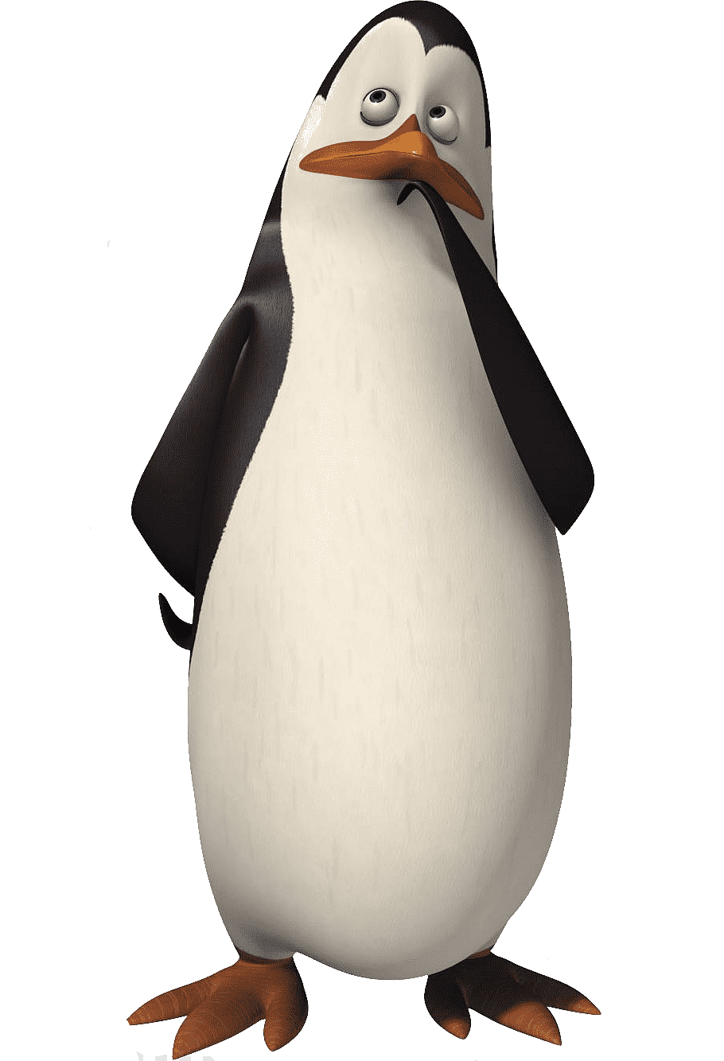
SPEAKING
I just saw the most amazing movie, it was a(n) ........... film. What is your favorite kind of movie?
I really like ........................ My favorite one is ..................
Hmm, I don’t like those that much. Why do you like that kind of movie?
Well, I would have to say because they are ...................................
That is a good reason. If I had to choose a ........... that I like, it would be ......................
I remember that movie, I think it is ....................

Slide 23
PROJECT

Slide 24
Thank you and see you next lesson!

